Slide 1
Comparison of Energy Cost and Carbon Emissions for Air-Source Heat Pump and Natural Gas Furnaces in the US
Nathan Oliver

Slide 2

Self-Introduction
Education
BS - Mechanical Engineering - New Mexico State University
MS - Sustainable Energy Technology - Xi’an Jiaotong-Liverpool University
Experience
1 yr – Mechanical Engineer
5 yrs – English / Physics Teacher
1 yr – Project Manager
I have lived in China for the past 8 years, and I recently moved to Denver
Hobbies
Skiing
Soccer
Hiking

Slide 3
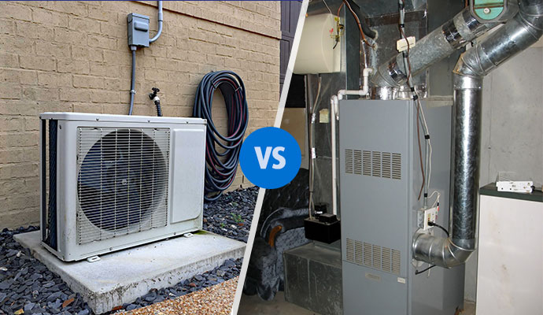
Introduction
Desire to complete a building energy simulation project in 2022
Comparison of Air-Source Heat Pumps (ASHP) and Natural Gas Furnaces in a typical US single-family home
Energy Costs
Carbon Emissions
Initial project using BEOpt to compare ASHPs and natural gas furnaces in various US cities showed promising results
Final project compared the two heating systems in all US counties

Slide 4



Overview
Project Flowchart
IDF Files
EPW Weather Files
Python Simulation Flowchart
Energy Costs
Electricity
Natural Gas
Carbon Emissions
Electricity
Natural Gas
Calculations
Results
Conclusions
Future Improvements

Slide 5
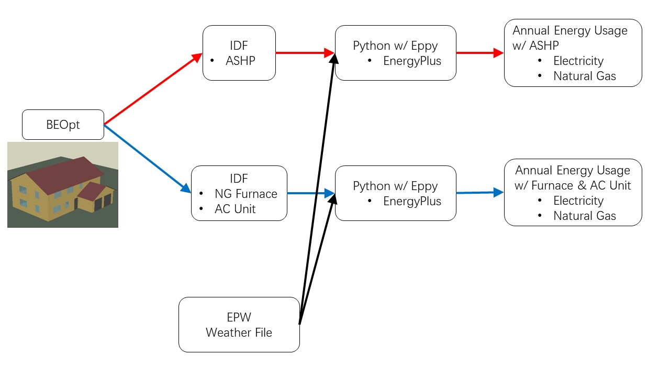
Project Flowchart – Part 1

Slide 6
Project Flowchart – Part 1

Slide 7
Project Flowchart – Part 1

Slide 8
Project Flowchart – Part 1

Slide 9
Project Flowchart – Part 1

Slide 10
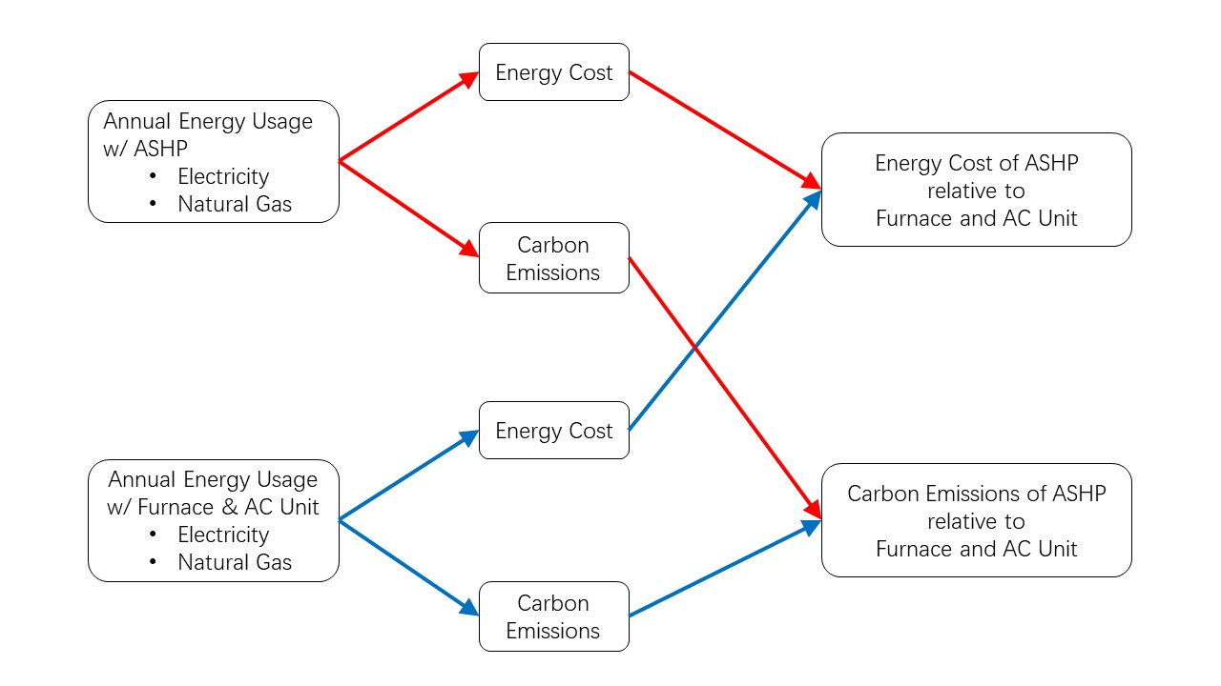
Project Flowchart – Part 2

Slide 11
Project Flowchart – Part 2

Slide 12
Project Flowchart – Part 2

Slide 13
IDF Files
EPW Files
Python Simulation Flowchart

Slide 14

IDF Files
3D Building Model in BEOpt
Created building envelope in BEOpt
Exported two different IDF files, each with its own heating and cooling systems
Scenario 1
Air-Source Heat Pump
SEER 22, 10 HSPF, Variable Speed
Scenario 2
Natural Gas Furnace
95% AFUE
AC Unit
SEER 22
Building envelope remained the same for every simulation, regardless of ASHRAE zone

Slide 15
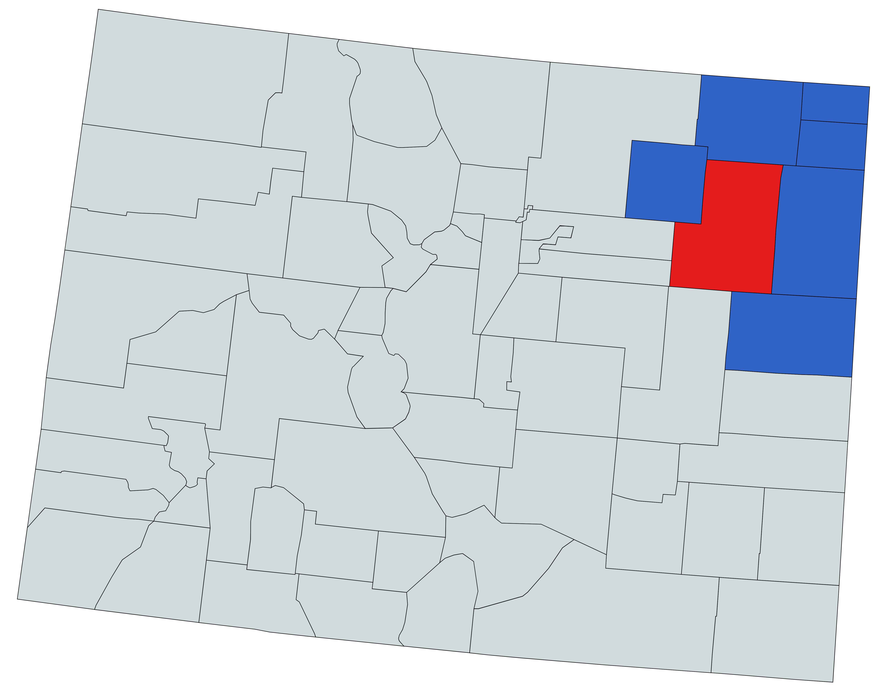
EPW Weather Files
Weather files for 3,128 US counties are available from NREL.
The US contains 3,143 counties and county equivalents
The counties with missing weather files were replaced using weather files from neighboring counties
The NREL EPW weather file set only used 881 weather stations
Multiple counties would use weather data from the same weather station
Reduced simulation time by about 70%
Washington County and neighboring counties use the same weather data from Akron Washington County Airport
Map of Colorado

Slide 16
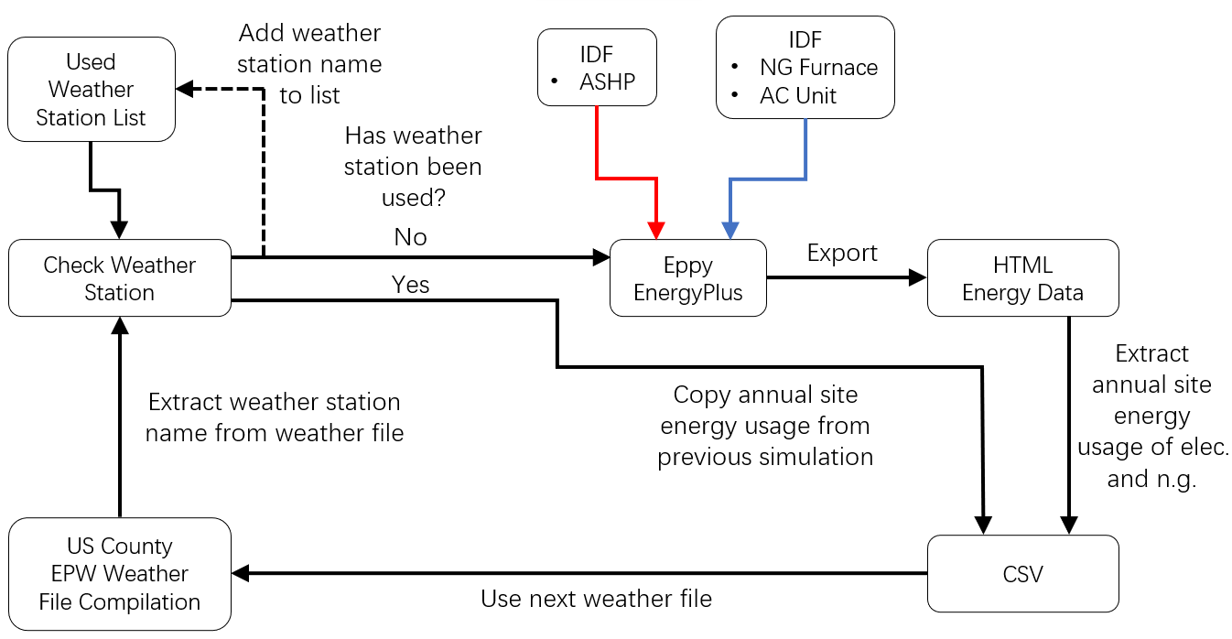
Python Simulation Flowchart

Slide 17
Python Simulation Flowchart

Slide 18
Python Simulation Flowchart

Slide 19
Python Simulation Flowchart

Slide 20
Python Simulation Flowchart

Slide 21
Python Simulation Flowchart

Slide 22
Python Simulation Flowchart

Slide 23
Python Simulation Flowchart

Slide 24
Python Simulation Flowchart

Slide 25
Python Simulation Flowchart

Slide 26
Python Simulation Flowchart

Slide 27
Python Simulation Flowchart

Slide 28
Energy Costs

Slide 29
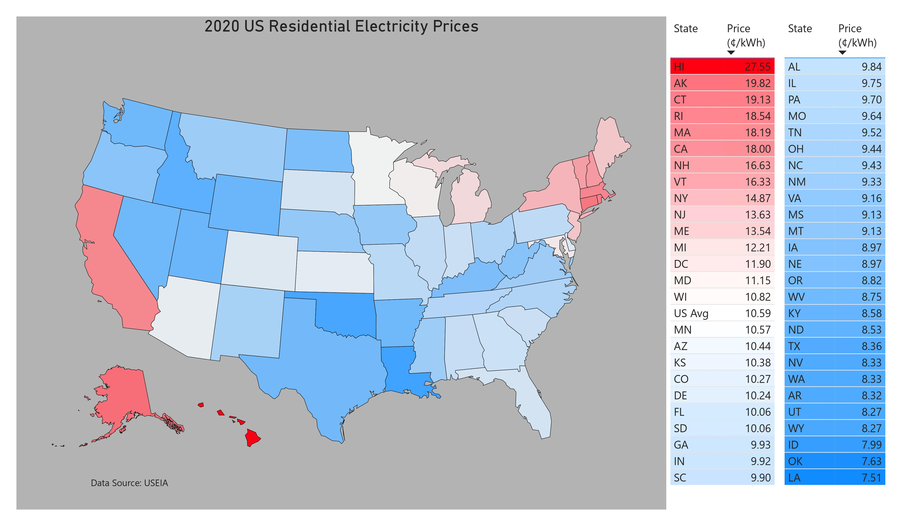
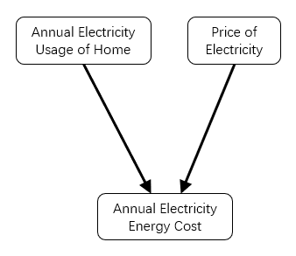
Electricity – Energy Cost
State-level electricity and natural gas prices were used to calculate energy costs
County-level prices were not readily available
2020 US Residential Electricity Prices
Electricity Cost Calculation Flowchart

Slide 30
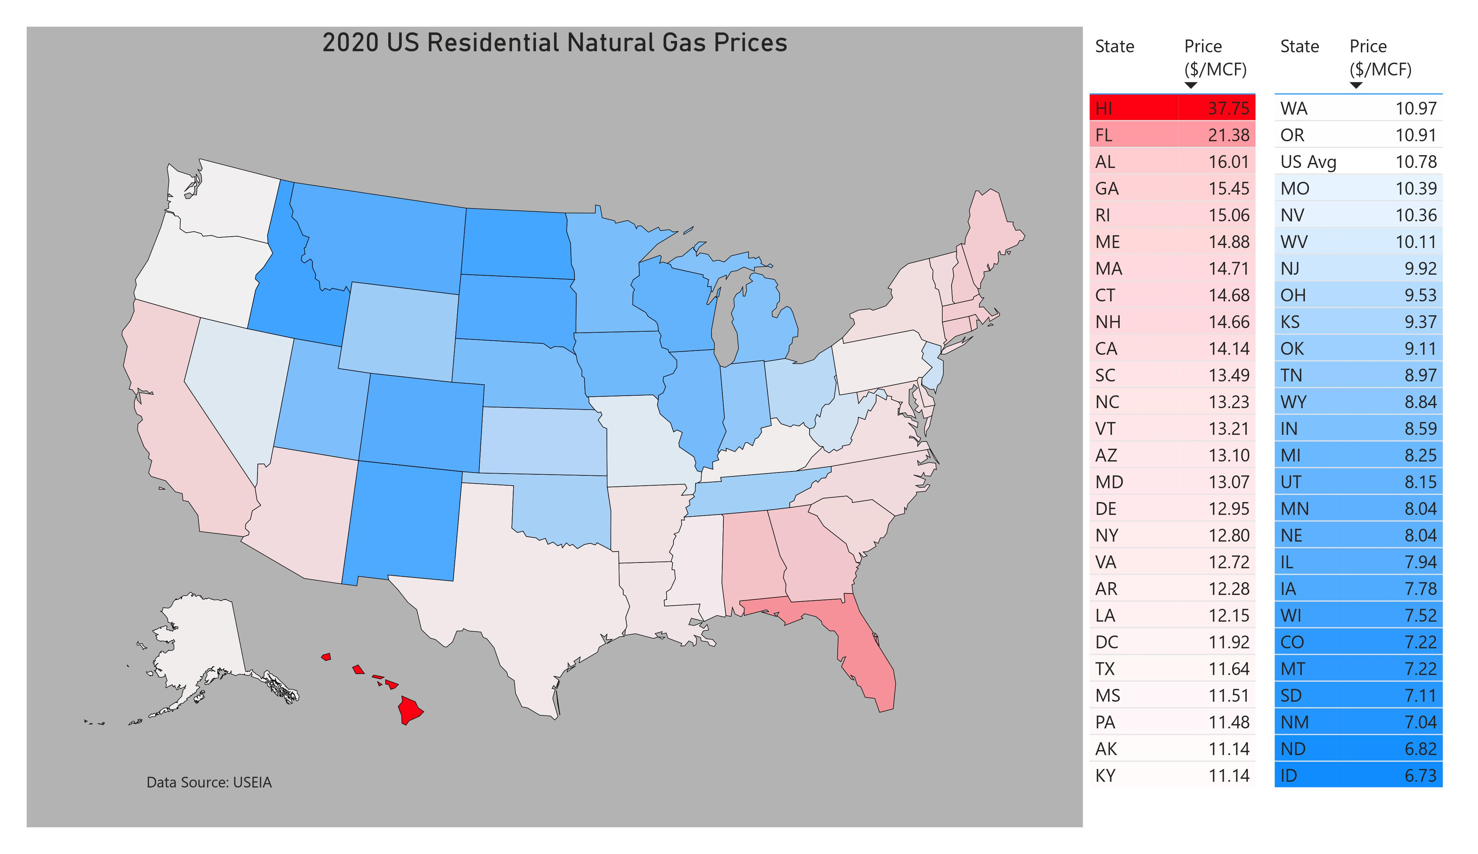
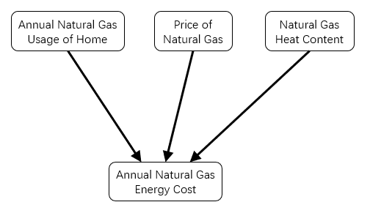
Natural Gas – Energy Cost
Price of natural gas is listed in dollars per unit volume
A conversion was needed to convert from volume to amount of energy
Heat content of natural gas
US Average - 1,037 btu/cubic foot [USEIA]
2020 US Residential Natural Gas Prices
Natural Gas Cost Calculation Flowchart

Slide 31
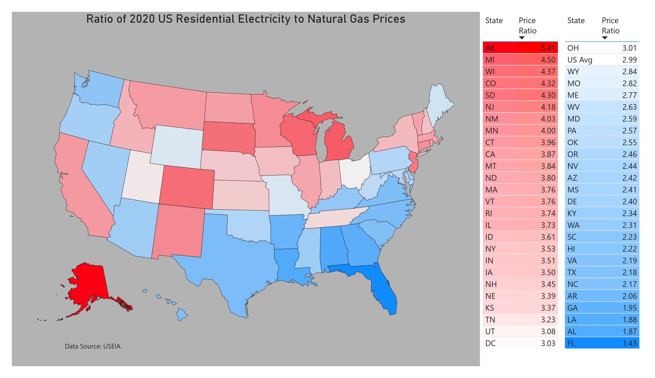
Prices of Electricity and Natural Gas
Ratio of 2020 US Residential Electricity to Natural Gas Prices
Price of Electricity to Natural Gas Ratio
Unitless value
US Avg – 3.0
AK – 5.4
FL – 1.4
Map strongly correlates to energy cost comparison of ASHPs and natural gas furnaces
Energy costs for ASHPs tend to be less expensive in states that are blue

Slide 32
Carbon Emissions

Slide 33
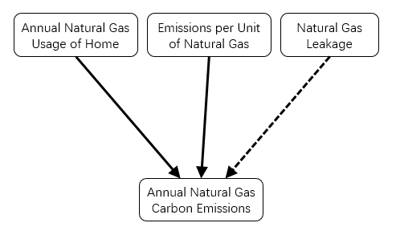
Natural Gas – Carbon Emissions
Carbon emissions from burning natural gas
52.91 kg/MMBtu [USEIA]
Emissions from natural gas due to transportation and flaring were ignored
Including emissions from these sources may significantly impact emissions from operating furnaces
Natural Gas Carbon Emissions Calculation Flowchart

Slide 34
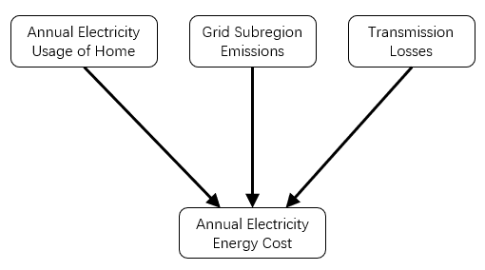
Electricity – Carbon Emissions
Grid Subregions
Regions defined by the North American Electric Reliability Corporation (NERC), which include different transmission organizations and balancing authorities
Defined by the EPA to accurately determine the emission rates from different regions in the US
Transmission Losses
Vary depending on location
Continental US – 5.1%
Alaska – 5.4%
Hawaii – 5.5%
Electricity Carbon Emissions
Calculation Flowchart

Slide 35
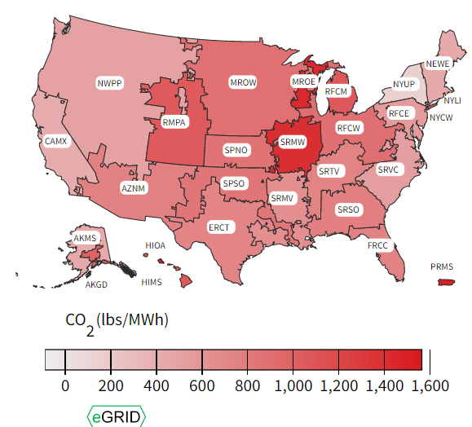
Grid Subregion Carbon Emissions
US Grid Subregion Carbon Emissions Map

Slide 36
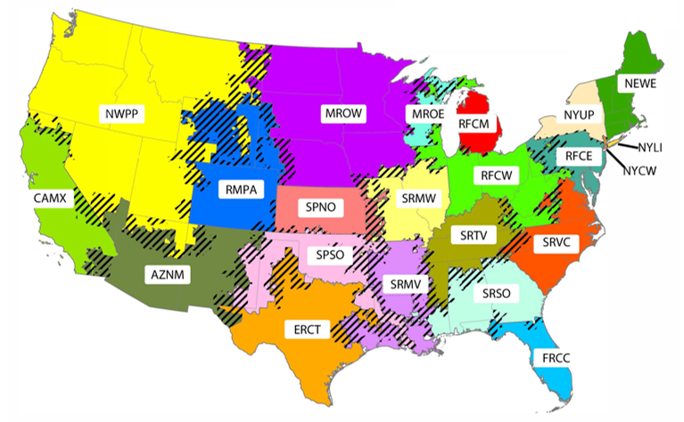
Assigning a Grid Subregion to Each County
US Grid Subregion Map

Slide 37
Assigning Grid Region for Each County
ZIP Code | Grid Subregion
00010 | AKMS
00011 | AKGD
00012 | CAMX
00014 | AZNM
… | …
80010 | RMPA
… | …
99927 | AKMS
99928 | AKMS
99929 | AKMS
99950 | AKMS
County Name | ZIP Code | Grid Subregion
Denver | 80010
Denver | 80012
Denver | 80014
Denver | 80022
… | … | …
Denver | 80291
Denver | 80293
Denver | 80294
Denver | 80299
List of all zip codes in every US county
(Only Denver County is shown for explanation purposes)
List of every zip code and its corresponding grid subregion

Slide 38
Assigning Grid Region for Each County
ZIP Code | Grid Subregion
00010 | AKMS
00011 | AKGD
00012 | CAMX
00014 | AZNM
… | …
80010 | RMPA
… | …
99927 | AKMS
99928 | AKMS
99929 | AKMS
99950 | AKMS
County Name | ZIP Code | Grid Subregion
Denver | 80010
Denver | 80012
Denver | 80014
Denver | 80022
… | … | …
Denver | 80291
Denver | 80293
Denver | 80294
Denver | 80299

Slide 39
Assigning Grid Region for Each County
ZIP Code | Grid Subregion
00010 | AKMS
00011 | AKGD
00012 | CAMX
00014 | AZNM
… | …
80010 | RMPA
… | …
99927 | AKMS
99928 | AKMS
99929 | AKMS
99950 | AKMS
County Name | ZIP Code | Grid Subregion
Denver | 80010
Denver | 80012
Denver | 80014
Denver | 80022
… | … | …
Denver | 80291
Denver | 80293
Denver | 80294
Denver | 80299

Slide 40
Assigning Grid Region for Each County
ZIP Code | Grid Subregion
00010 | AKMS
00011 | AKGD
00012 | CAMX
00014 | AZNM
… | …
80010 | RMPA
… | …
99927 | AKMS
99928 | AKMS
99929 | AKMS
99950 | AKMS
County Name | ZIP Code | Grid Subregion
Denver | 80010
Denver | 80012
Denver | 80014
Denver | 80022
… | … | …
Denver | 80291
Denver | 80293
Denver | 80294
Denver | 80299

Slide 41
Assigning Grid Region for Each County
Used the value_counts() function to count the different grid regions for each county, and then find the subregion with the highest frequency
Most counties would only have a single grid subregion
For counties that were in two or more subregions, whichever subregion had the highest frequency would be assigned to that county
County Name | ZIP Code | Grid Subregion
Denver | 80010
Denver | 80012
Denver | 80014
Denver | 80022
… | … | …
Denver | 80291
Denver | 80293
Denver | 80294
Denver | 80299

Slide 42
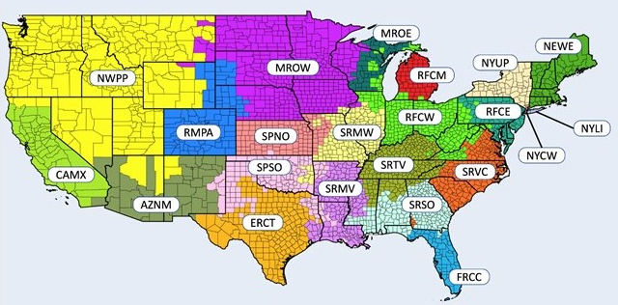
Assigning Grid Region for Each County
USEPA
US Grid Subregion Map
Python Generated
US Grid Subregion Map

Slide 43
Electricity – Carbon Emissions
Python Generated
US Grid Subregion Map
Electricity Carbon Emissions
Calculation Flowchart

Slide 44
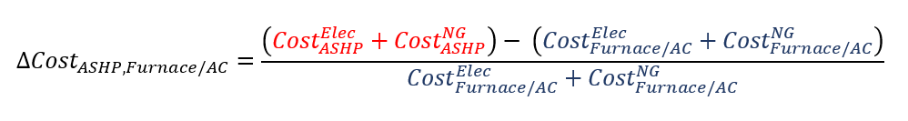
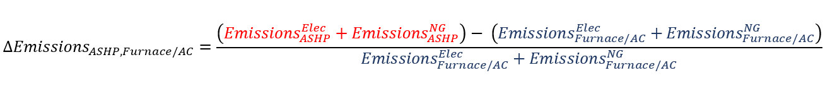
Comparing ASHPs to Natural Gas Furnaces - Calculations
Annual home energy cost to operate ASHP relative to furnace/AC unit
Annual home emissions to operate ASHP relative to furnace/AC unit
Note: AC fan energy consumption was removed. Results with fan consumption did not closely match initial BEOpt results

Slide 45
Results

Slide 46
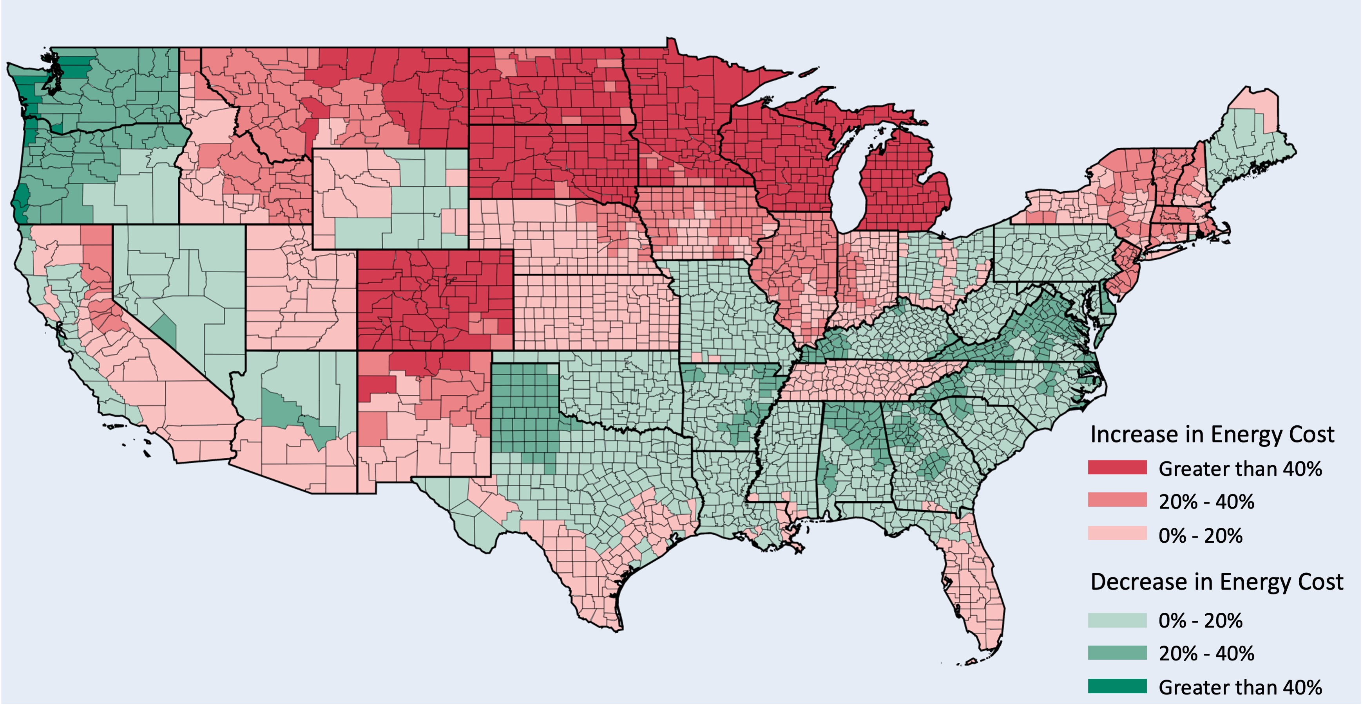
Results – Energy Costs
Annual home energy cost to operate ASHP relative to furnace/AC unit by US County

Slide 47
Results – Energy Costs
Annual home energy cost to operate ASHP relative to furnace/AC unit
by US County
Ratio of 2020 US Residential Electricity to Natural Gas Prices

Slide 48
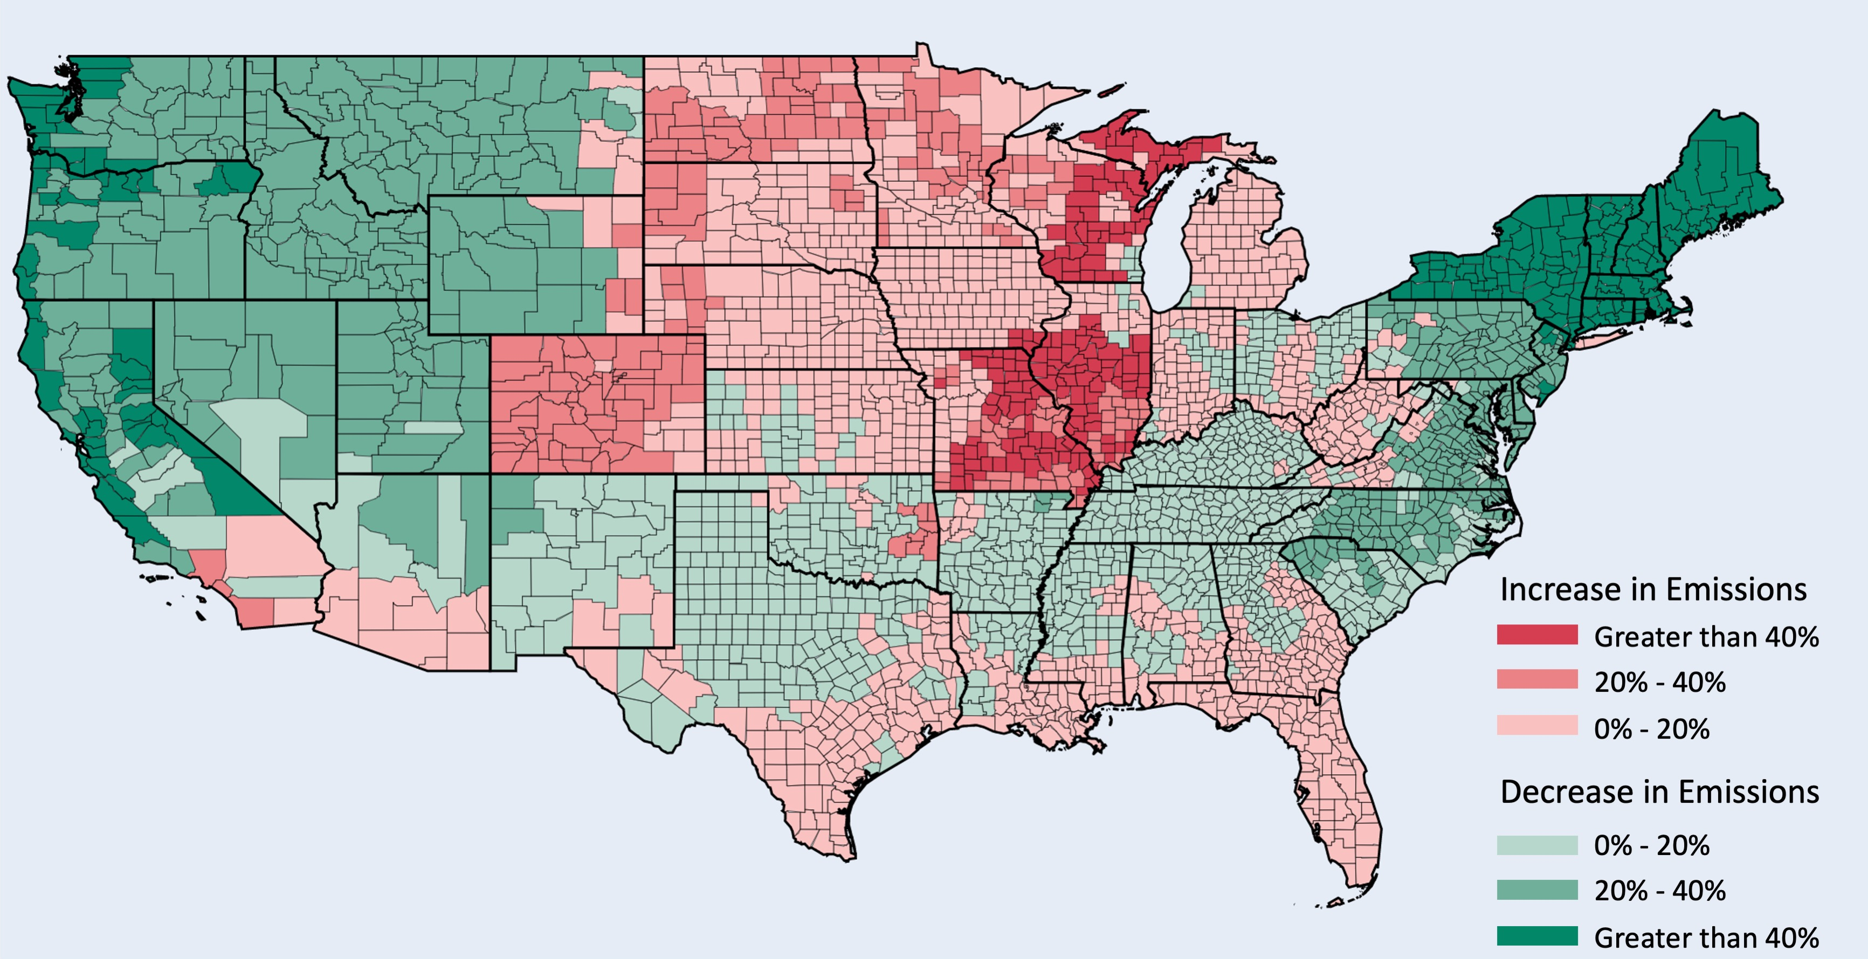
Results – Carbon Emissions
Annual home emissions to operate ASHP relative to furnace/AC unit by US County

Slide 49
Results – Carbon Emissions
Annual home emissions to operate
ASHP relative to furnace/AC unit
by US County
US Grid Subregion
Carbon Emissions Map

Slide 50
Conclusion
Annual home emissions to operate
ASHP relative to furnace/AC unit
by US County
ASHPs have lower emissions on the west coast and northeast US
ASHPs tended to emit more emissions in colder environments
Colder environments decreased ASHP COP
Natural gas tended to be less expensive in colder regions
Strong correlation between grid emissions and ASHP emissions relative to natural gas furnaces
Strong correlation between electricity to natural gas price ratio and ASHP energy costs relative to natural gas furnaces

Slide 51
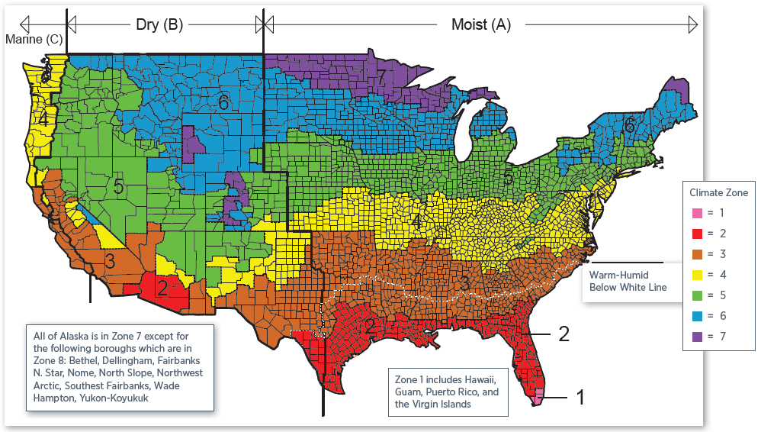
Future Improvements
Adjust building envelope to conform to ASHRAE requirements for each ASHRAE zone
Use electricity and natural gas prices on a county-level basis, instead of state-level prices
Calculate emissions and costs based on a shorter-time interval, such as monthly, instead of annually.
Gather results by state or by region
Calculate annual costs, which would include upfront costs for each technology
Improve visualizations (ex. Include Alaska and Hawaii in all maps)
ASHRAE Climate Zone Map

Slide 52
Thank You

Slide 53
Appendix – Electricity Prices with Table

Slide 54
Appendix – Natural Gas Prices with Table

Slide 55
Appendix – Elec:NG Price Ratio with Table

Slide 56
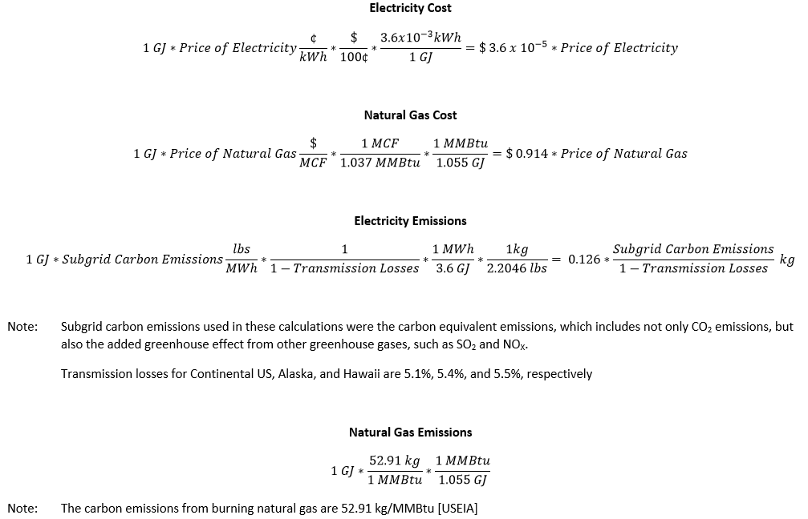
Appendix - Equations

Slide 57
Appendix - Equations

Slide 58
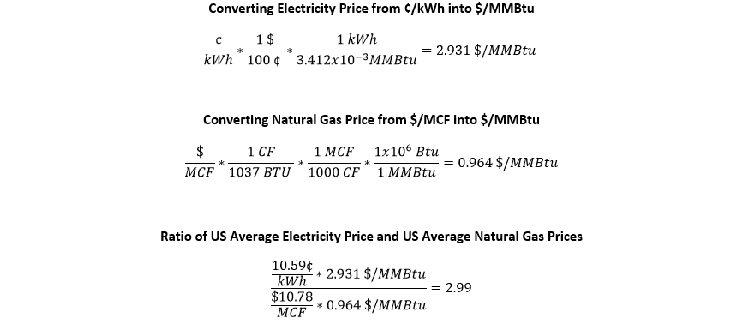
Appendix - Equations

Slide 59
Appendix – IDF File
Area: 2500 sqft
Type: 3-bed, 2 bath, 3 floors (inc. conditioned attic)
Orientation: South
Walls: R-45 Double Wood Stud
Ceiling: R-60
Slab: R-20
Windows: Triple-pane U-Value 0.17 btu/h-ft2-R, 314 sqft
Door: U-Value 0.20 btu/h-ft2-R, 20 sqft
Air Leakage: ACH50
Ducts: In finished space
Cooling Set Point: 75 °F
Heating Set Point: 70 °F
Humidity Set Point: None

Slide 60
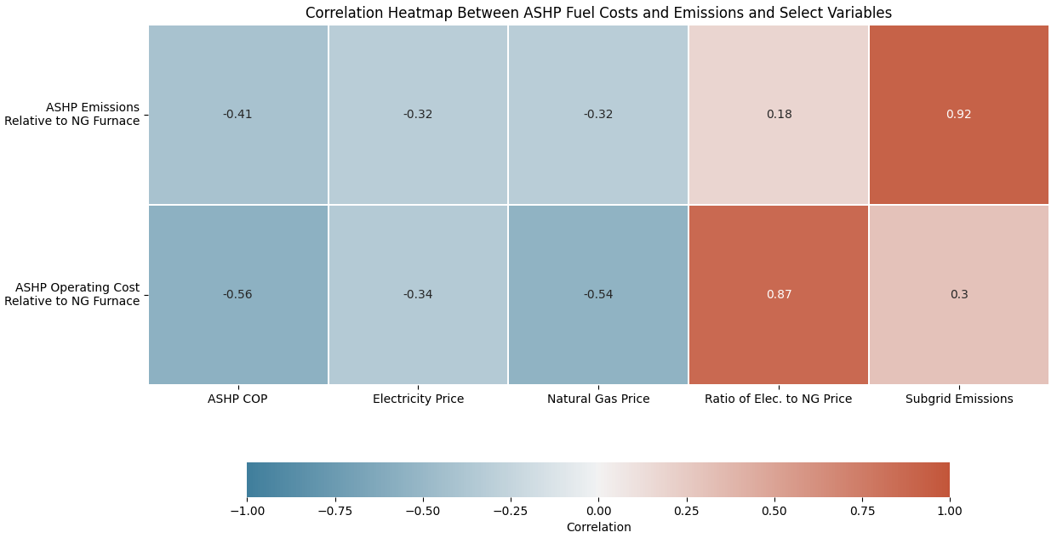
Appendix – Correlation Heatmap

Slide 61
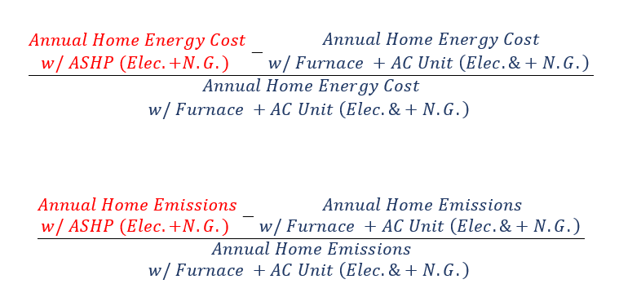
Comparing ASHPs to Natural Gas Furnaces - Calculations

Slide 62
References
Bianchi, Carlo; Fontanini, Anthony (2021, May 11): TMY3 Weather Data for ComStock and ResStock. National Renewable Energy Laboratory. 10.7799/1756695. Retrieved from https://data.nrel.gov/submissions/156
USEIA (2022, October 5). Carbon Dioxide Emissions Coefficients. USEIA. Retrieved from https://www.eia.gov/environment/emissions/co2_vol_mass.php. Natural Gas Carbon Dioxide Factor (Kg CO₂/MMBtu)
USEIA (2021, December 30). Heat Content of Natural Gas Consumed. USEIA. Retrieved from https://www.eia.gov/environment/emissions/co2_vol_mass.php 2020. US Natural Gas Heat Factor (btu/ft³)
USEIA (2021, December 30). Natural Gas Prices. USEIA. Retrieved from https://www.eia.gov/dnav/ng/ng_pri_sum_a_EPG0_PRS_DMcf_a.htm. 2020 Residential Prices
USEIA (2021, November 4). State Electricity Profiles. USEIA. Retrieved from https://www.eia.gov/electricity/state/archive/2020/
USEPA (2021, September 22). eGRID Summary Tables 2019. eGRID Summary Tables (XLSX), Table 1 Tab. Retrieved from https://www.epa.gov/egrid/power-profiler#/
USEPA (2022, March 1). Power Profiler Terms, Calculations, and Data Sources. USEPA. Retrieved from https://www.epa.gov/system/files/documents/2021-09/power-profiler-terms-calculations-and-data-sources-9-21-2021.pdf
USEPA (2021, September 22). Power Profiler ZIP Code Tool with eGRID2019 Data v10.0. Power Profiler Emissions Tool 2019 (XLSX), Zip-Subregion Tab. Retrieved from https://www.epa.gov/egrid/power-profiler#/

